Slide 1
The Role of Open-Source Toolkits in Advancing Chemical Registration Systems: A Case Study from Novartis
David Deng, Riccardo Vianello
RDKit North America UGM, Cambridge, MA
April 10th, 2025

Slide 2
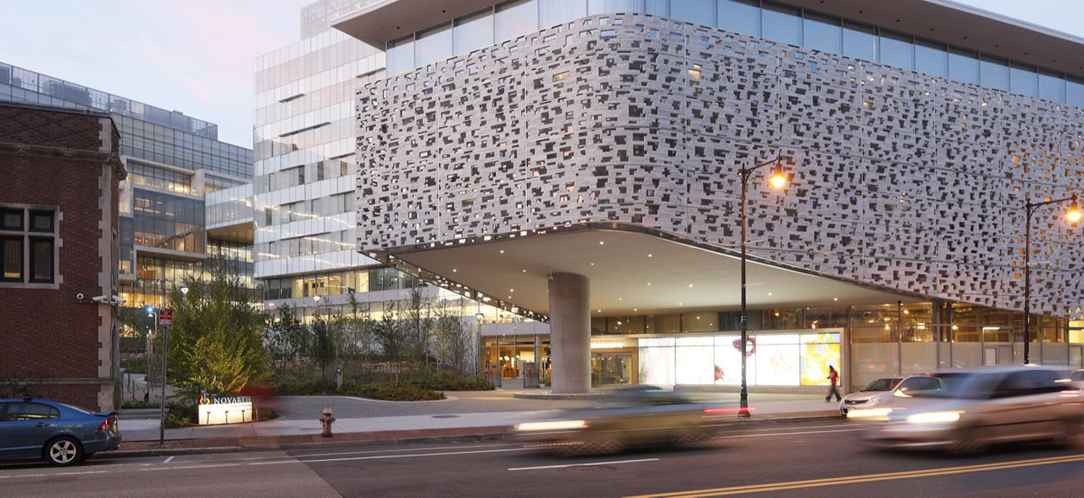
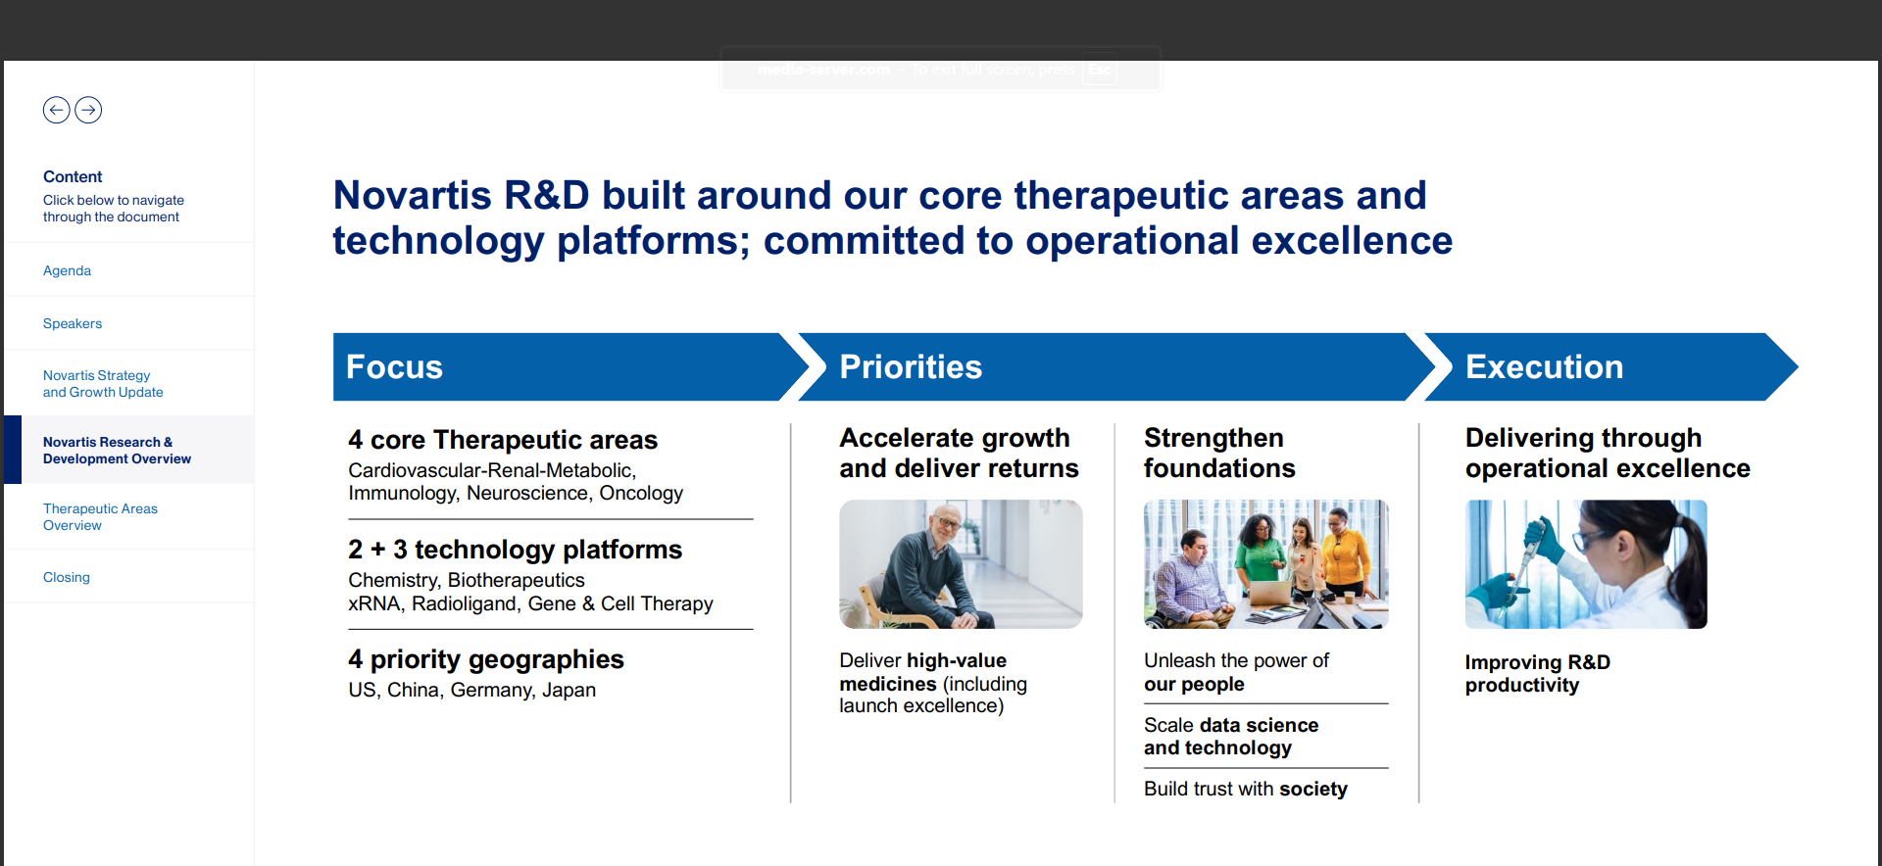
Novartis and Speaker Introduction

Slide 3

SMR: Small Molecule Registration
NVP-ABC123
+
A sophisticated chemical structure
NVP-ABC123-AA-1

Slide 4
SMR: Small Molecule Registration
SMC: Small Molecule Concept - Structure “drawing” (Molfile) - Stereo category - Structure descriptor - [...]
Sample Information
registration
+
SMS: Small Molecule Sample - Amount - Purity - Salt and solvate information - [...]

Slide 5
SMR: Small Molecule Registration
SMC: Small Molecule Concept - Structure “drawing” (Molfile) - Stereo category - Structure descriptor - [...]
+
SMS: Small Molecule Sample - Amount - Purity - Salt and solvate information - [...]

Slide 6
SMR: Small Molecule Registration
SMC: Small Molecule Concept - Structure “drawing” (Molfile) - Stereo category - Structure descriptor - [...]
Reference chemical structure It may not always accurately reflect the physical state of the compound in the sample, but it’s most suitable to uniquely identify the compound
+
SMS: Small Molecule Sample - Amount - Purity - Salt and solvate information - [...]

Slide 7
SMR: Small Molecule Registration
SMC: Small Molecule Concept - Structure “drawing” (Molfile) - Stereo category - Structure descriptor - [...]
Stereochemistry metadata Complements the structure representation when the stereochemistry is partially known or undefined and/or insufficiently described by the Molfile format
+
SMS: Small Molecule Sample - Amount - Purity - Salt and solvate information - [...]

Slide 8
SMR: Small Molecule Registration
SMC: Small Molecule Concept - Structure “drawing” (Molfile) - Stereo category - Structure descriptor - [...]
+
SMS: Small Molecule Sample - Amount - Purity - Salt and solvate information - [...]
Sample information Composition details and references to project, eLN experiment, or external source

Slide 9
SMR: Small Molecule Registration
SMC: Small Molecule Concept - Structure “drawing” (Molfile) - Stereo category - Structure descriptor - [...]
Business rules:
Concept and sample are required to refer to a single chemical entity: => Mixtures are not allowed/supported
Exception: racemic/diasteromeric mixtures
Note: tautomers represent distinct SMCs
+
SMS: Small Molecule Sample - Amount - Purity - Salt and solvate information - [...]

Slide 10
SMR: Small Molecule Registration
SMC: Small Molecule Concept - Structure “drawing” (Molfile) - Stereo category - Structure descriptor - [...]
Validation and standardization
Molfile (standardized)
NIBR InChI
MolKey
NVP-ABC123
+
SMS: Small Molecule Sample - Amount - Purity - Salt and solvate information - [...]
(concept nvp + salt code + “batch counter”)
NVP-ABC123-AA-1

Slide 11
SMR: Small Molecule Registration
SMC: Small Molecule Concept - Structure “drawing” (Molfile) - Stereo category - Structure descriptor - [...]
Validation and standardization
Molfile (standardized)
NIBR InChI
MolKey
NVP-ABC123
+
SMS: Small Molecule Sample - Amount - Purity - Salt and solvate information - [...]
NVP-ABC123-AA-1
(concept nvp + salt code + “batch counter”)
NVP-ABC123-NX-2
...
NVP-ABC123-..-n

Slide 12
SMR: Small Molecule Registration
SMC: Small Molecule Concept - Structure “drawing” (Molfile) - Stereo category - Structure descriptor - [...]
Validation and standardization
Molfile (standardized)
NIBR InChI
MolKey (hash)
NVP-ABC123
Rejects chemical structures that may be interpreted as incorrect, ambiguous (by other software and/or end users) or that prevent the full characterization of the compound (e.g. R groups)
Ensures compliancy of the structure drawing with business rules and QA (legibility) criteria
Plays a key role in determining the chemical identity of the concept molecule associated to the sample
+
SMS: Small Molecule Sample - Amount - Purity - Salt and solvate information - [...]
NVP-ABC123-AA-1
(concept nvp + salt code + “batch counter”)
NVP-ABC123-NX-2
...
NVP-ABC123-..-n

Slide 13
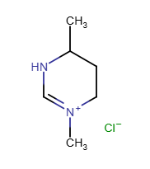
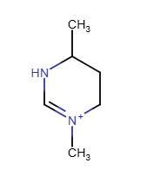
Background and Motivation
STRUCHK
“Very mature” and stable C library, but with some known issues/limitations
Developed in-house, but maintenance had become increasingly challenging
The code base was difficult to adapt to evolving requirements

Slide 14
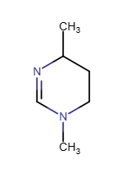

Background and Motivation

Slide 15
Main requirements
Focus on 2D Molfile representation. Reject input designated as 3D or with inconsistent 2D/3D information
Reject Molfile features not suitable for SMR (e.g., query atoms/bonds)
Port STRUCHK’s 2D layout and stereochemistry validation to RDKit
Reimplement other validation and standardization features using RDKit
Preserve explicit H and stereo bonds (try not to annoy chemists with too many “cosmetic” changes)
Similar API as STRUCHK, but return more detailed error and information messages

Slide 16
High-level implementation
Input
Validation
Input features
Valencies, Isotopes, Radicals
2D Layout
Stereochemistry
Standardization
Disconnect metals
Normalize
Keep largest fragment
Reapply wedging
Reapply Molfile wedging
Remove wavy bonds
Cleanup 2D Layout
Clear any non-zero Z coords
Scale
Make parent
Output
Parent
Neutralize
Replace dative bonds
16

Slide 17
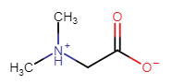
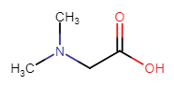
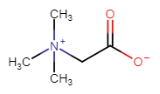
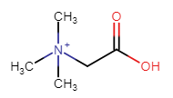
Output and Parent structure
Output: Represents the registered entry (the “display” molecule)
Parent: Uniquely identifies the “concept” molecule
Motivating use-case: zwitterions
Output
Parent
17

Slide 18
Development Iteration
Tested on 5M+ internal registered compounds
Compare results with STRUCHK
Mismatching results were reviewed, discussed and fixed/justified

Slide 19
Timeline and Notes
June 2024 July 2024 September 2024
Internal RDKit build deployed to SMR PROD
Main pipeline implementation contributed by Novartis to RDKit
Part of RDKit 2024_09 release
This test collected detailed information about the quality of structures in SMR (~20K invalid structures identified and annotated)
A copy of the original input submitted for registration is now persisted in the SMR database
The validation status (compliancy w/ current validation rules) of all concept records is now explicit tracked in the SMR DB and available to consumers of the registration data
Easier future updates to the validation + standardization pipeline

Slide 20




Ongoing Work and Next Steps
In Progress | Planned | Under Discussion | Just an idea
Bulk rewrite of the display and parent structures of previously registered compounds | Enable support for V3000 Molfile format (=> large molecules, coordinative bonds) | Partial curation of invalid concept data with 3D coordinates | Improve the collection/logging of Molfile input from rejected submissions
 | Implement the same validation code to other systems

Slide 21
Acknoledgements
Novartis
Sandra Wildhaber
Vladislav Mikutel
Raev Aleksei
Paolo Tosco
Jason Elliott
Markus Furegati
Constanze Hartwieg
John Isbell
Maurice van Eis
RDKit
Greg Landrum
21

Slide 22
Thank you

Slide 23
23

Slide 24
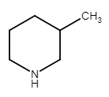
SMR: Small Molecule Registration
SMC: Small Molecule Concept - Structure “drawing” (Molfile) - Stereo category - Structure descriptor - [...]
Stereo category: Single compound – unknown stereochemistry Structure descriptor: (e.g., chiral HPLC conditions, retention time, etc)
+
SMS: Small Molecule Sample - Amount - Purity - Salt and solvate information - [...]
Amount: 42 mg
Purity: 90%
Salt: Hydrochloride (Salt code: AA)

Slide 25
Invalid SMCs in SMR
# | Annotation | Description
8446 | BAD_STEREOCHEMISTRY | stereochemical information that is either ambiguous or incorrect
6966 | 3D | 3D designation or inconsistent 2D/3D information
3420 | MIXTURE | disconnected fragments e.g., counterions, solvent or different compounds
908 | UNSUPPORTED_FEATURES | unsupported or unsuitable Molfile features e.g., atom aliases, query atoms/bonds
592 | BAD_STRUCTURE | chemically incorrect (e.g., valences or isotopes specification) or unsuitable for registration (e.g., radicals)
115 | BAD_2D_DEPICTION | atoms clashing with other atoms/bonds or other 2D layout issues
6 | NO_COORDINATES | no non-zero coordinates (all atoms in the origin)

Slide 26
API
// instantiate a Pipeline instance with default settings MolStandardize::Pipeline pipeline;
// or
// configure the Pipeline with some specific options MolStandardize::PipelineOptions options; // [...] (options configuration) MolStandardize::Pipeline pipeline(options); // call the pipeline’s “run” method on an input molblock MolStandardize::PipelineResult result = pipeline.run(molblock);
26

Slide 27
API
The returned MolStandardize::PipelineResult instance collects all the details about the pipeline execution:
struct PipelineResult {
PipelineStatus status; // bitmask summarizing all the errors and info
std::uint32_t stage; // did the pipeline run to completion?
PipelineLog log; // a list of status flags and log messages
std::string inputMolData; std::string outputMolData; std::string parentMolData;
};
27

Slide 28
Configurability
struct PipelineOptions {
// parsing bool strictParsing{false};
// validation bool reportAllFailures{true}; bool allowEmptyMolecules{false}; bool allowEnhancedStereo{false}; bool allowAromaticBondType{false}; bool allowDativeBondType{false}; double is2DZeroThreshold{1e-3}; double atomClashLimit{0.03}; double minMedianBondLength{1e-3}; double bondLengthLimit{100.}; bool allowLongBondsInRings{true}; bool allowAtomBondClashExemption{true};
// metal disconnector options std::string metalNof{"[Li,Na,K,Rb,Cs,Fr]~[#7,#8,F]"}; std::string metalNon{};
// normalizer options std::string normalizerData{"[...]"};
// serialization bool outputV2000{false};
};
28

Slide 29
SMR: Small Molecule Registration
Key features:
Keeps track of which chemical compounds are synthesized or purchased internally
Keeps track of which samples provide a given compound
Holds the reference structure representation of internal compounds that is available to downstream products (e.g. CDF)

Slide 30
Re-building the structure validation and standardization pipeline in SMR
Outline
Background and motivation
Main requirements
Project execution (implementation, testing, integration)
Outcomes, current status and next steps

